Slide 1
Capstone Slide Deck
Payroll vs Winning in MLB
Will Pauls

Slide 2
Abstract
I have been a die-hard Royals fan since the day I was born.
Most Royals seasons in my life have ended without a playoff birth and not much winning at all.
The Royals have been known as a “cheap” organization.
Does an MLB teams payroll have a relationship with how well they did that season in terms of winning %?

Slide 3
Introduction
I have team and salary data for the 1985 through 2016 seasons via Lahman’s Baseball Database.
I will view proportion of teams whose winning increased based on their change in Payroll Rank and change in % of total MLB Payroll they have.
I will fit a linear regression model with winning % as the dependent variable
I will do some diagnostic tests to test the fit of the model, and then come to a conclusion.

Slide 4
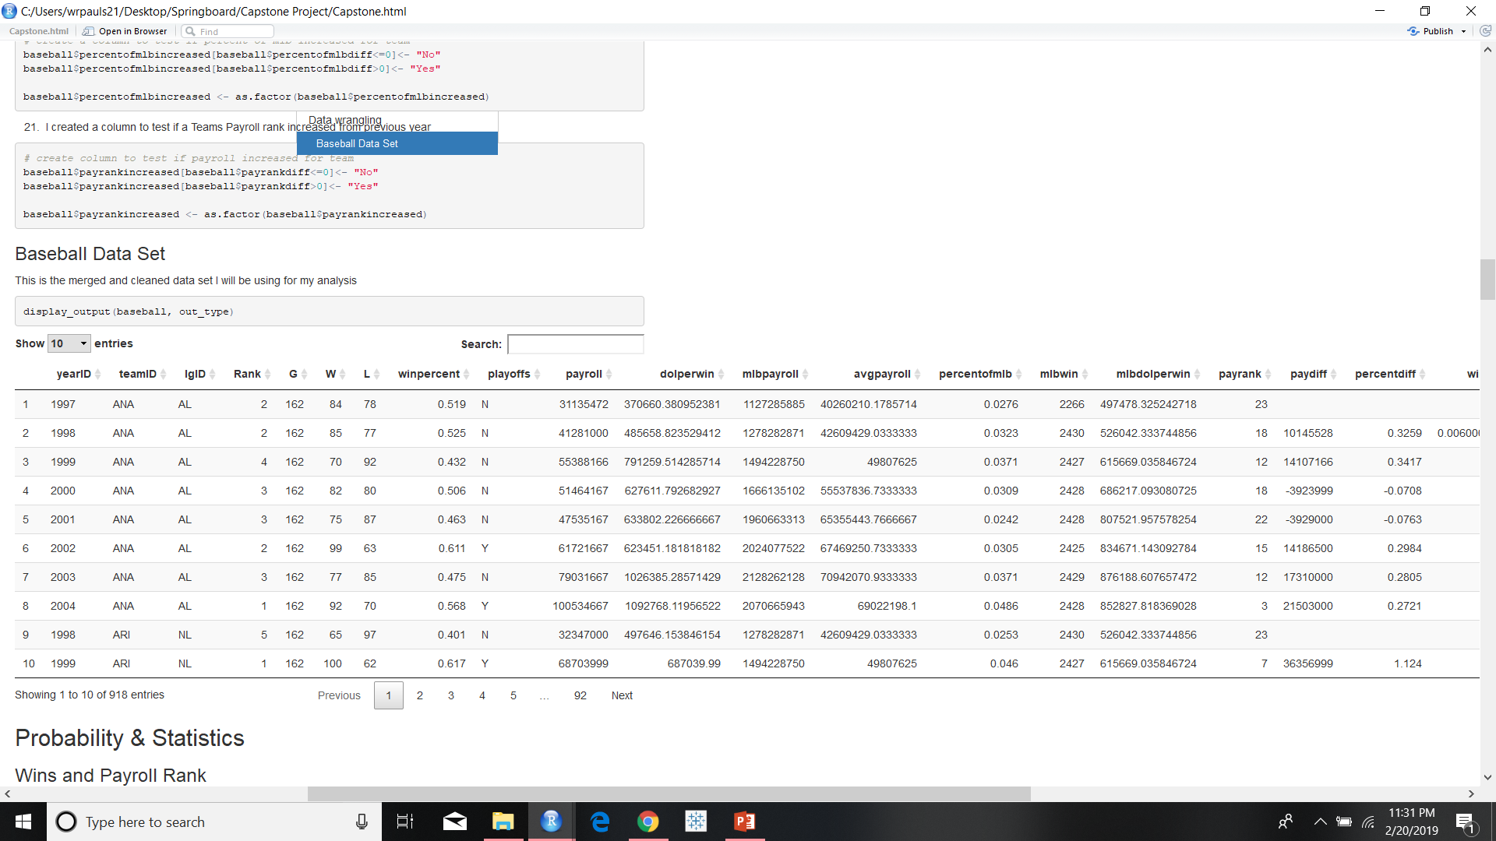
Data
The data that I used was pulled from the Teams and Salaries datasets from the Lahman baseball database.
After performing data wrangling tasks I merged them into a new dataset called baseball

Slide 5
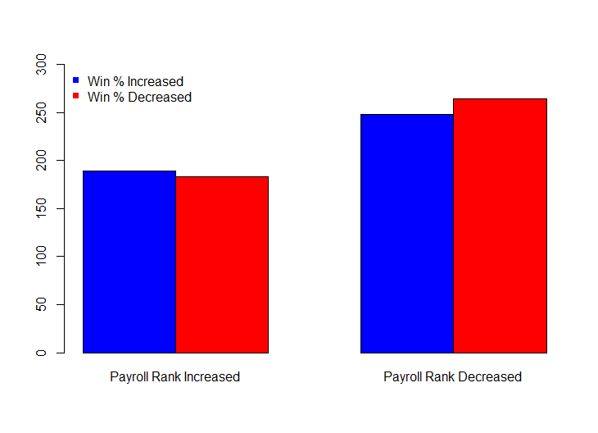
Win % and Payroll Rank +/-
A higher number of teams increases their win % after increasing their payroll rank from the previous year
A lower number of teams increases their win % after decreasing their payroll rank from the previous year
A one-sided z-test found a p-value of .2652 which is not enough evidence to reject the null hypothesis that the two proportions are equal to each other.

Slide 6
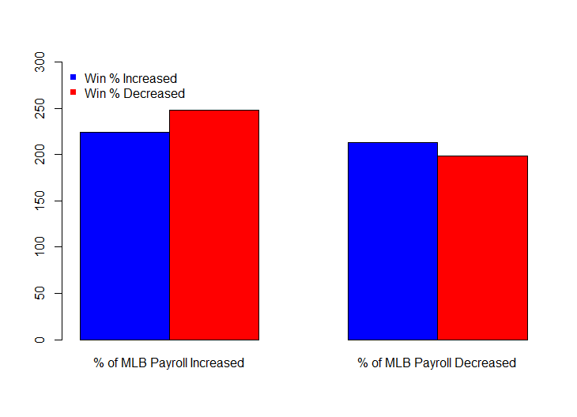
Win % and % of MLB Payroll +\-
A lower number of teams increases their win % after increasing their % of MLB payroll from the previous year
A higher number of teams increases their win % after decreasing their % of MLB payroll from the previous year
A z-test found a p-value of .2337 which is not enough evidence to reject the null hypothesis that the two proportions are equal to each other.

Slide 7
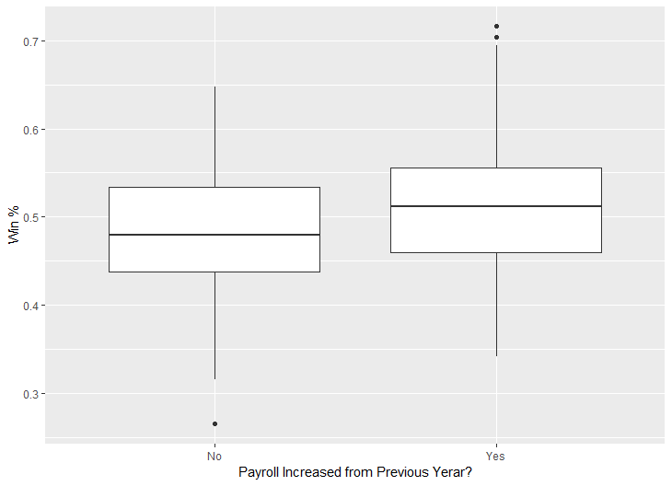
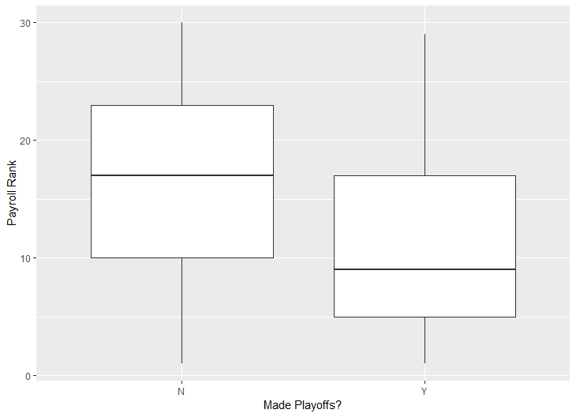
Supporting Boxplots
It is apparent that the amount of money a team puts into their payroll isn’t necessarily as important as where they rank in team payroll regardless of how much they spend.
For this reason, our linear regression model we will use in the Machine Learning section will use Payroll Rank as the Independent variable

Slide 8
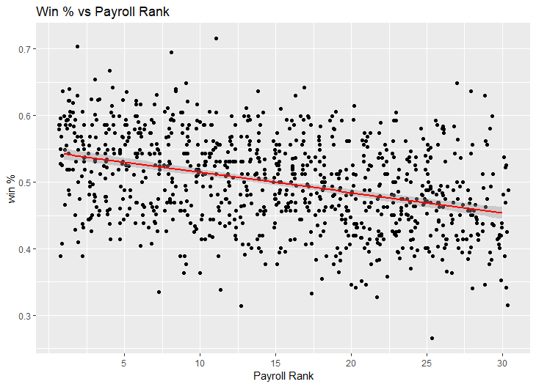
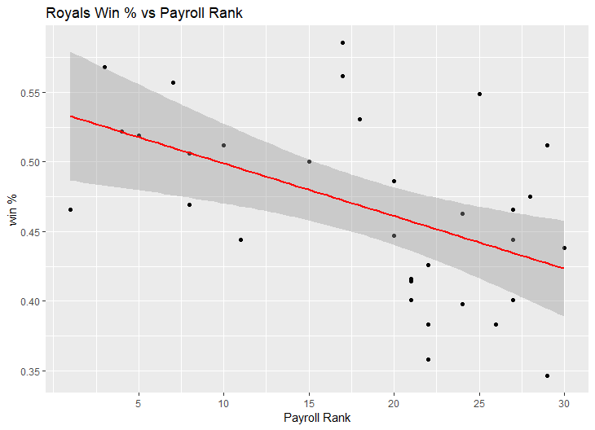
Linear Regression
The plot of team payroll rank and winning % showed a clear negative linear relationship.
As Teams drop lower in the ranks of team payroll, their winning % is expected to also decrease.
The same plot with just the Royals shows the same trend as the entire MLB
The model passed all of the diagnostic tests confirming that it is a good model fit.
The model showed a significant relationship between payroll rank and winning % at an α = .05 level
We can conclude that there is a relationship between where a team ranks in team payroll and their winning %

Slide 9
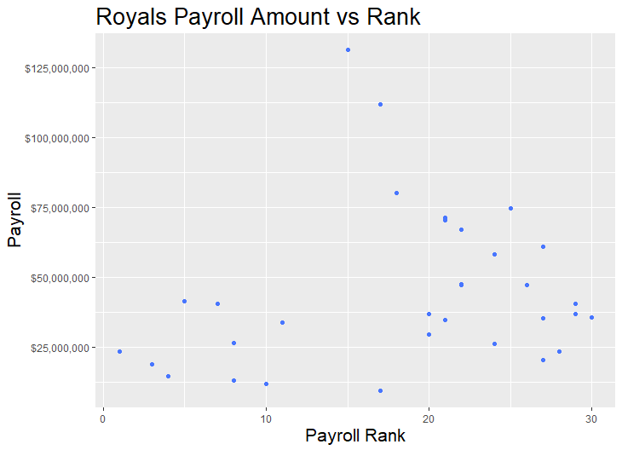
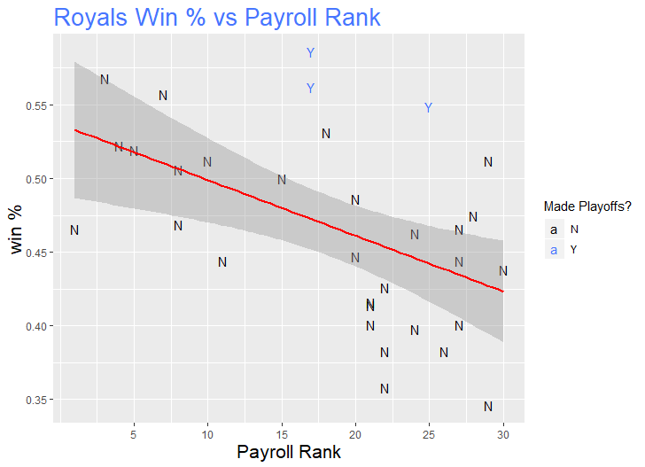
Additional Royals Plots

Slide 10
Conclusion
The amount of money spent in team payroll isn’t crucial in increasing your winning % as long as you are spending more than your competitors.
It matters more to rank ahead of other teams in Payroll regardless of dollar amount spent than it does to just throw money at players.
The Royals follow a similar negative relationship between Payroll Rank and Win % that support my findings when looking at the entire MLB.

